Slide 1
END OF LIFE (E.O.L.C)
Bridget Flynn

Slide 2
OBJECTIVES
Understanding the concept of end of life care and what end of life means to you?
Being aware of the Gold Standard Framework and how it differs in ICU?
Discussing a scenario from the perspective of patient, family and care giver.
Post care after death including appropriate documentation.
Being aware of what were doing in our EOL inter team project.

Slide 3
What do we mean by END OF LIFE and what does it mean to you?

Slide 4
END OF LIFE
There is no clear-cut definition of the “end of life “it refers to the last few days of life when a person is irreversibly dying also known as the terminal phase (NICE 2017). Another scope of guidance includes care of people who are likely to die within 12 months (Royal College of Surgeons).

Slide 5
END OF LIFE CARE
End of life care is care that helps all with advanced, progressive incurable illness to live as well as possible until the day they die.
It enables the supportive and pallative care needs of both patients and their families/close friends to be identified and met through the last phase of life and into bereavement and makes provisions for psychological, social, spiritual and practical support. (NICE 2004).

Slide 6
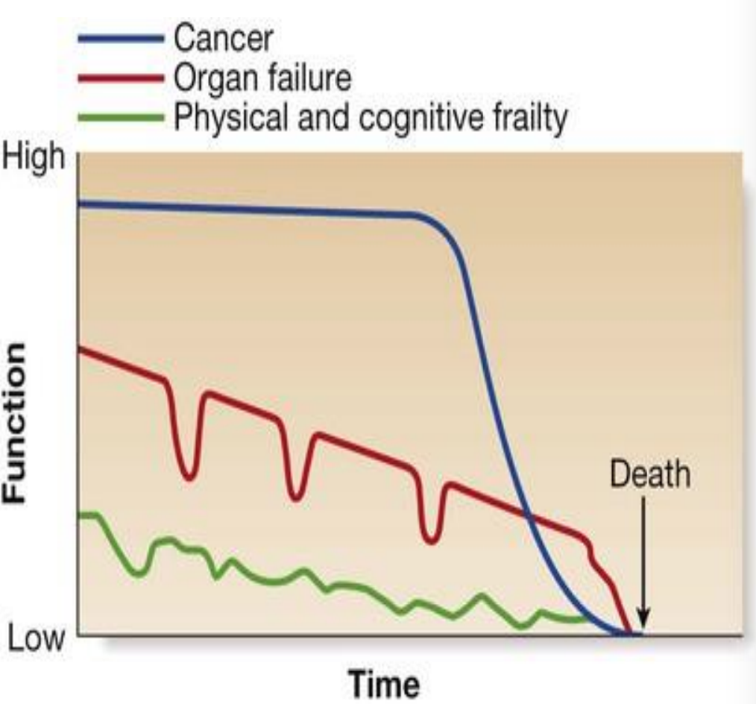
TRAJECTORY

Slide 7
GOLD STANDARD FRAMEWORK (GSF)
This is a framework used by many G.P. practices, care homes and hospitals, to enable earlier recognition of patients with life limiting conditions, helping them to plan and live as well as possible right to the end.

Slide 8
There is a G.P. pallative care register including patients who are seriously ill and considered to be in their final stage of life.
Some parts of the country GSF is used in many settings and this improves coordination of care and helps in the sharing of information across sites. Some patients have a “gold” card and a gold folder with important and useful information about available services and electronic notes shared.
This help everyone know that the gold patients should be prioritised to ensure they receive more speedy care and they are aware of the patients wishes so that they can be fulfilled. This helps link together all the people caring and ensures that the care is cross boundary.

Slide 9

CODING

Slide 10
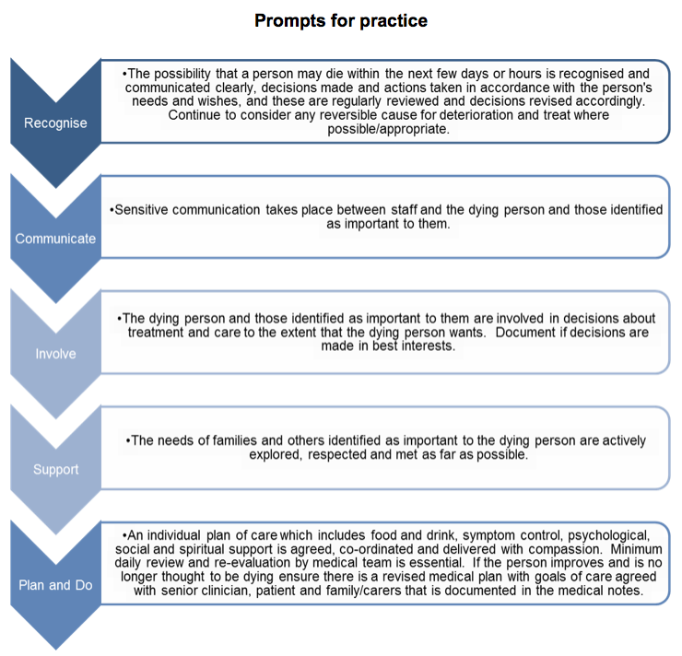

Slide 11
ICU
Our ICU is not using the GSF as it is not applicable in this setting.
Difficult to identify patients as a lot of patients being admitted to ICU would present as patients in their last few days of life as they are so sick.
Unable to ascertain patient’s wishes as sometimes too unwell to engage in this conversation.
It’s not just one consultant looking after the pts there is many consultants who inter change throughout the week whom may differ in opinions and care options.
In C+W ICU instead we us the Compassionate Care Agreement document. Beforehand a Do Not Resuscitation Plan (DNACPR) must be signed by a consultant and reviewed every 24 hours

Slide 12
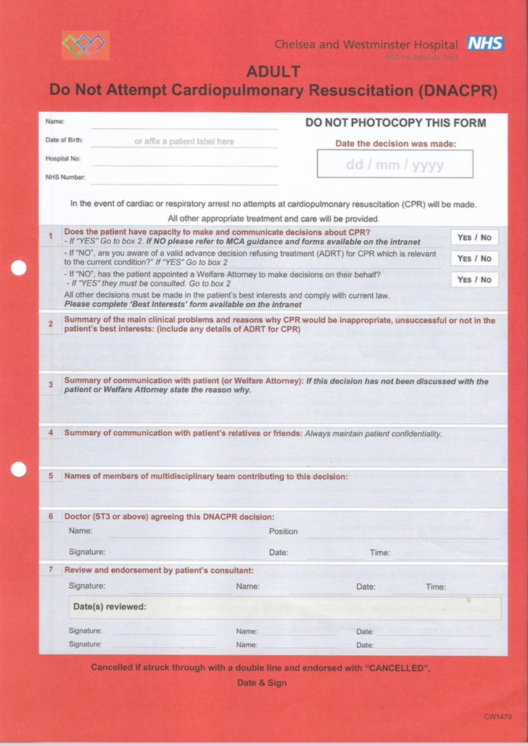

Slide 13
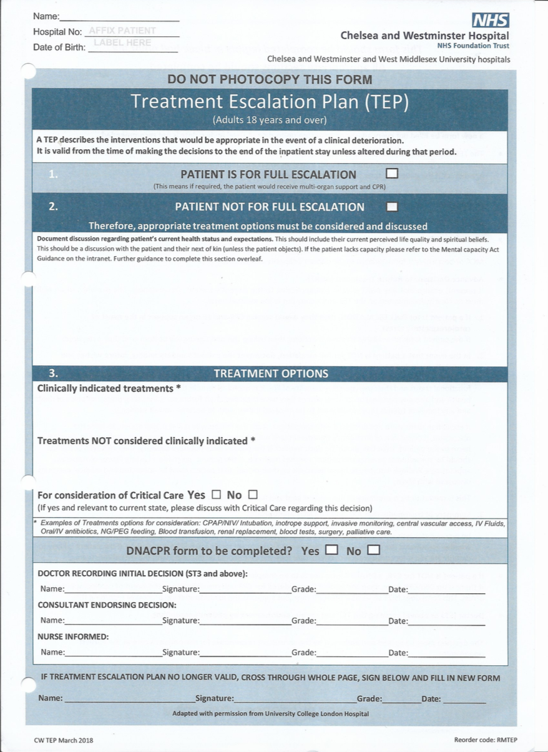

Slide 14
COMPASSIONATE CARE AGREEMENT
This is an individualised care plan.
It should be utilised for adult in- patients expected to die within days or hours.
This must be agreed with the patient if possible or a significant other that is identified as most important to the patient (NOK).

Slide 15
AIM OF COMPASSIONATE CARE AGREEMENT
Ensures high quality of care in the final days/hours of life
Identify patients personal wishes and needs if able to do so
Clear good communication.
Collaborate with other care settings/members of multidisciplinary team where applicable

Slide 16
SENARIO
Mrs x a 65-year-old lady admitted to ICU with very bad pancreatitis sepsis and multi organ failure. Requiring ventilation with a difficult airway, hemofiltration and inotropic support.
PAST MEDICAL HISTORY:
Severe Asthma
Heart failure
Spina Bifida
Bilateral below knee amputation
Wheelchair bound

Slide 17
SOCIAL
She lived with her sister who was older than her and was finding it increasingly difficult to care for her. Her sister was in ill health and had mental health issues also. She has a carer TDS to help her get out of a bed and with activities of daily living.
Mrs x spent months in ICU. It was a roller coaster of a journey. She was constantly getting infections requiring multidose abx, hemofiltration, and inotropic support. Had a few pneumothoraxes and required chest drains. Her pancreas had almost disintegrated and she was constantly getting abdominal infections requiring Abdo drains. The abdo drains could not be removed. Mrs x was eventually sent to the ward but a week later returned after deteriorating further with sepsis and multi organ failure. Again, intubated, inotropes but not responding to treatment.

Slide 18
What might you be thinking about this?
What might you want to consider saying to the doctors?
What physical, psychological, spiritual and social needs might there be for:
Mrs x?
for her sister?
And for YOU the care giver and the team?

Slide 19
PHYSICAL NEEDS
PATIENT | FAMILY | CAREGIVER
To be pain free. (opioids) (positioning). | Encourage families to sit and talk to their loved ones | It can be very stressful so encourage to talk and take some breaks
Fear of breathlessness (? opioids). | Offer drinks so they don’t get dehydrated | Drink plenty fluids
Having copious respiratory tract secretions(hyoscine) (positioning) (small dose fio2). | Provide information and encourage to ask | Ask for help if needed in the situation

Slide 20
PHYSICAL NEEDS
PATIENT | FAMILY | CAREGIVER
Agitation/delirium fear? (benzodiazepines) (massage)(music) | Questions
Nausea and Vomiting (antiemetics). | Offer them a place to rest in one of our delegated rooms

Slide 21
PHYSICAL NEEDS
Other Things to Consider for the Patient
symptoms such as itchiness/oedema (Priton)
Personal Hygiene
Unnecessary interventions (blood tests, inotropes)
Unnecessary medications
Skin integrity
Mouth/eye care
Urinary problems (pads? Cather).
Constipation (laxatives)
Nausea and Vomiting (antiemetics).

Slide 22
Emotional and psychological needs
PATIENT | FAMILY | CAREGIVER
Open and honest communication, active listening to the patient can be helpful. Asking if they have a person in mind for a Lasting Power of Attorney or have, they made an Advanced Care Directive. | Open an honest communication and being present, listening and offering support. No right and wrong on how they choose to spend last moments with their loved ones. Offer a side room for privacy if available or pull the curtains. | Sitting with family members and trying to create a bond with them – you get attached and get emotional. Looking after you and getting rest and a better work life balance.

Slide 23
Emotional and psychological needs
PATIENT | FAMILY | CAREGIVER
Care explained | Care explained | Debriefing about the situation
Offer if appropriate to speak to the psychologist on the unit | Involve family members in giving care to patients (mouth care). Encourage to hold patients’ hand. Drop cot sides so they can get closer | Attend Schwartz rounds. To help you make sense of your feelings and reflect on practices and Ask for support from other team members
Help contact any family members for patient if so wishes to see | Offer to speak to a psychologist | Speaking to the psychologist on the unit

Slide 24
CULTURAL AND SPIRUTALITY
PATIENT | FAMILY | CAREGIVER
Speak to the patient regarding any customs they have and what they prefer | Speak to the family about any customs they wish to carry out. Different religious beliefs | This may not be your culture or beliefs but it’s your responsibility to assist in any way you can to avoid discrimination always
Offer if an interpreter or IMCA is required | Offer if an interpreter is required for different languages | Try not to enforce spirituality onto people if they refuse, they have the right to

Slide 25
CULTURAL AND SPIRUTALITY
PATIENT | FAMILY | CAREGIVER
Ascertain what religion and if the patient would like to speak to somebody spiritual. | If they wish to speak to a spiritual advisor of some sort? Even if they are not religious or family member but they want to speak to somebody | You can also speak to the chaplain or spiritual leaders if you so wish
Is there any special relics or prayers they might like near them? | Tell them about the chapel and the multifaith/prayer room in the hospital | You can attend prayer/multifaith room if you require to do so

Slide 26
SOCIAL NEEDS
PATIENT | FAMILY | CAREGIVER
If going home making sure social services and care packages are reinstated | Giving families that have travelled long distances an overnight room reducing costs | Reflection and debriefing so that good practices applauded, and practice can be improved
Equipment or essentials sent home with the patient | Giving car parking concession forms to also helps with costs
Having family members present that patient wants | If documentation required for travel a letter can be organised

Slide 27
CARE AFTER DEATH
Inform the family and give them as much time as needed with their loved ones.
The Doctor must confirm the death.
Take care of the dead (last offices) – washing and preparing the body for to go to the morgue. Providing dignity and respect.
Family might like to help.
Certain religions have ways for the body to be presented.
If patient is for a post-mortem all lines cannot be removed.
The body to be placed carefully in a body bag due to infectious diseases policy.

Slide 28
CARE AFTER DEATH
Support and comfort the family and give them the bereavement booklet and organise an appointment for them for next day with bereavement officer If not the weekend. She will organise a time for the death certificate to be collected. Again, some religions like to receive the death certificate quickly so preparations can be made to honour the patients wishes. The bereavement officer will help with this
The family may wish to see their loved ones again before leaving giving them the time. Those who may not wish to see them should not to be made feel guilty for their choices
The patients belongings should be given back carefully making sure all is present according to the property form and record made of valuables on the patient’s body. The family should be made aware of these and decisions made whether to be taken home or to leave present

Slide 29
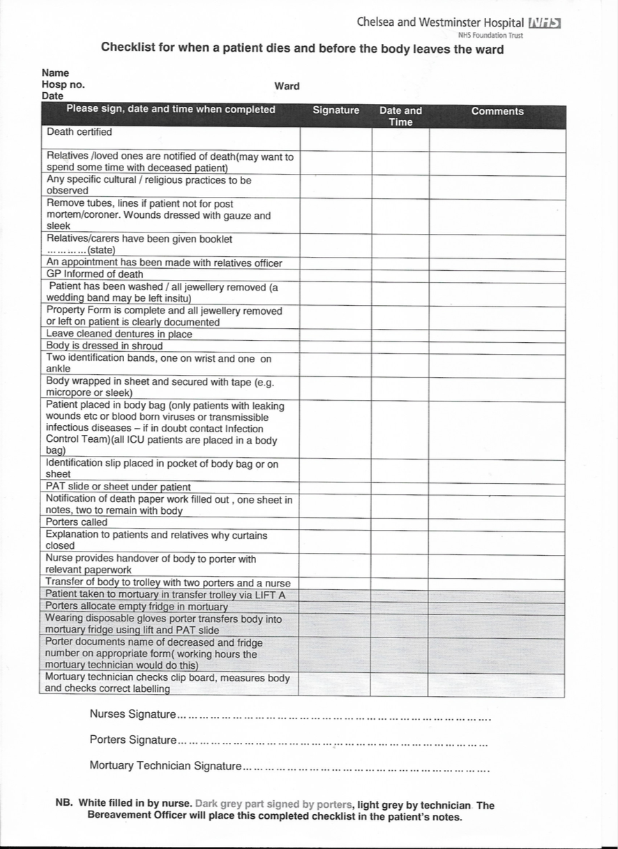

Slide 30
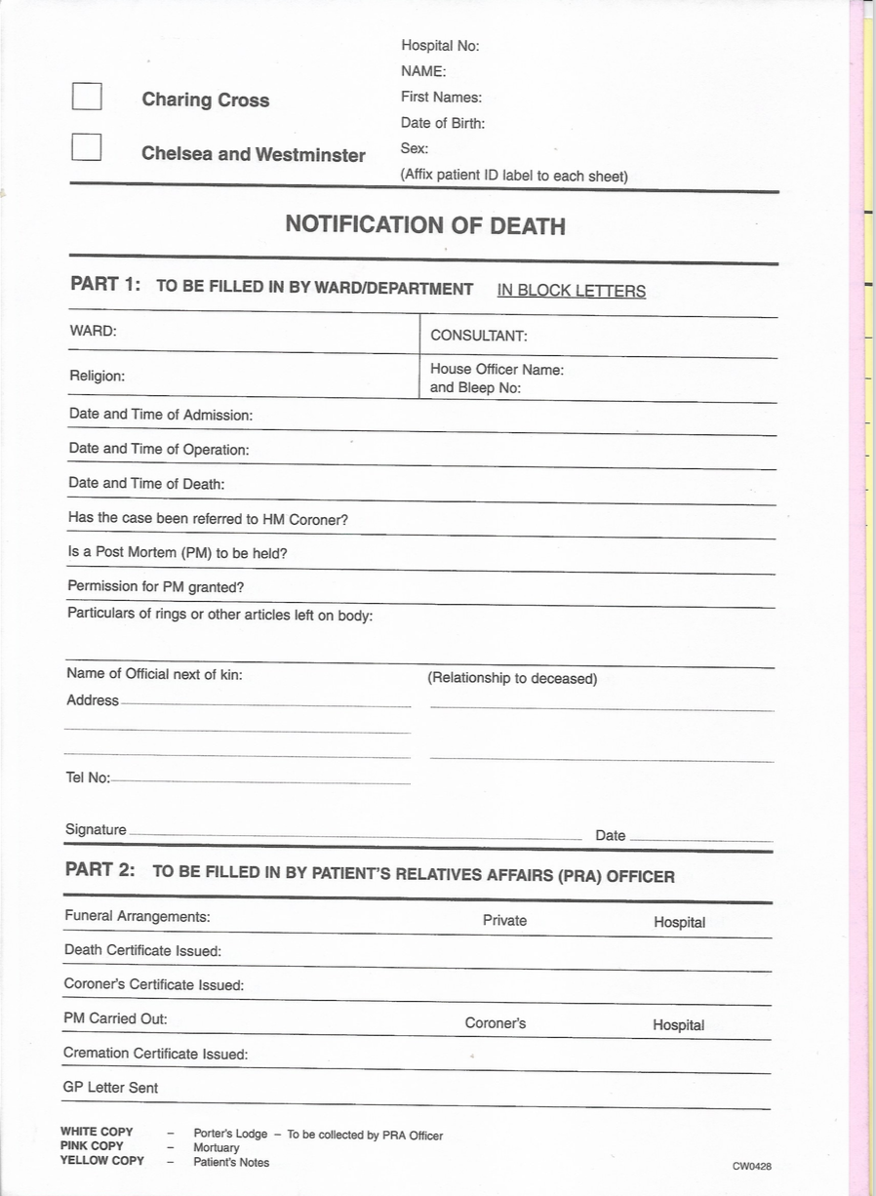

Slide 31
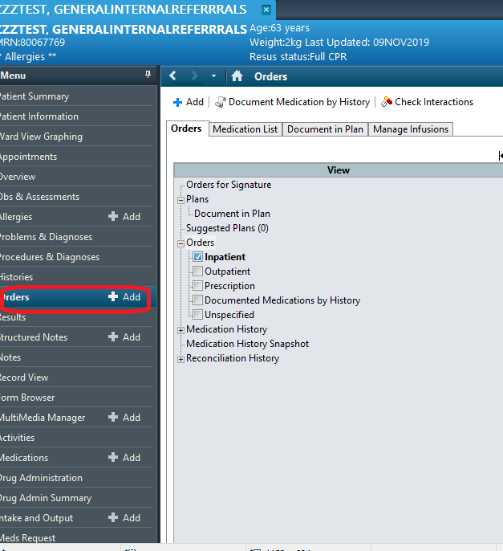

Slide 32
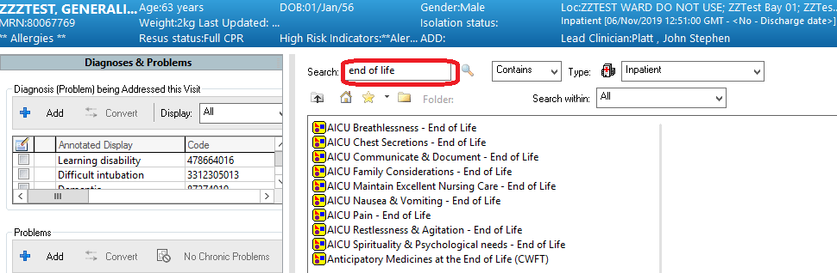

Slide 33
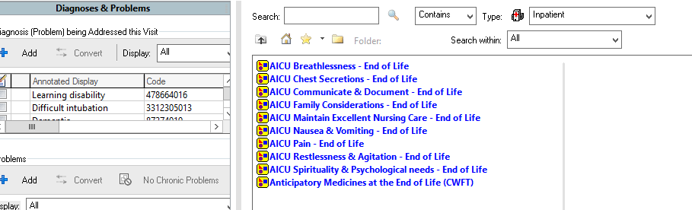

Slide 34
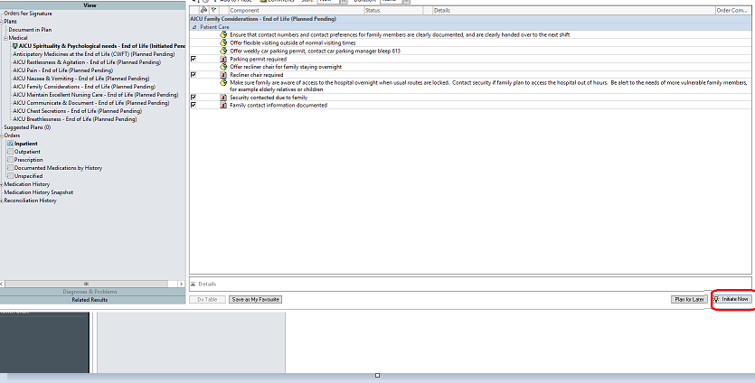

Slide 35
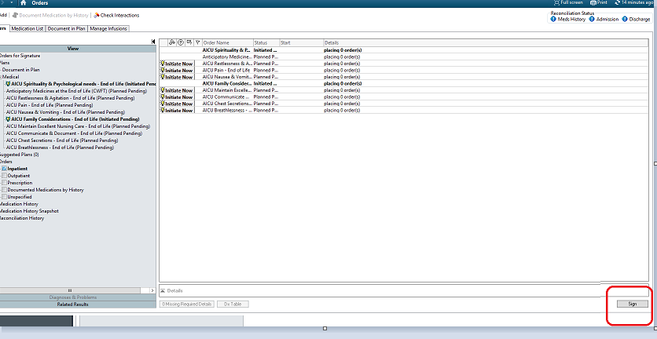

Slide 36
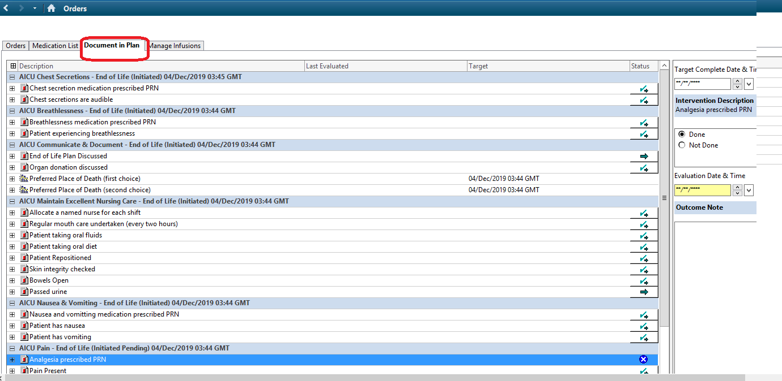

Slide 37
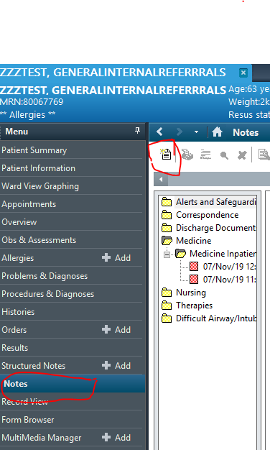

Slide 38
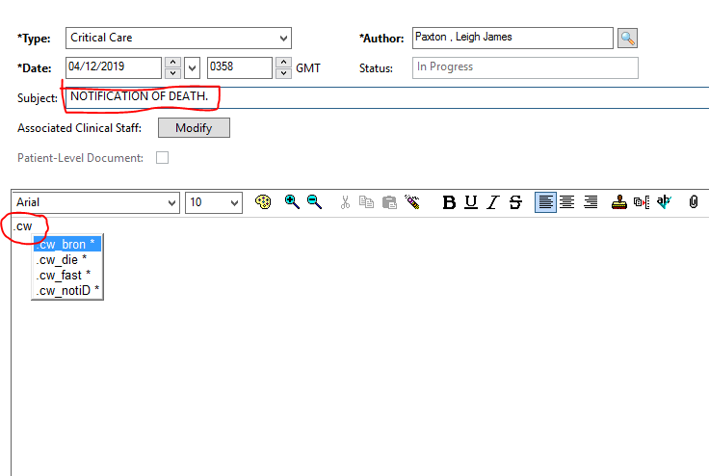

Slide 39
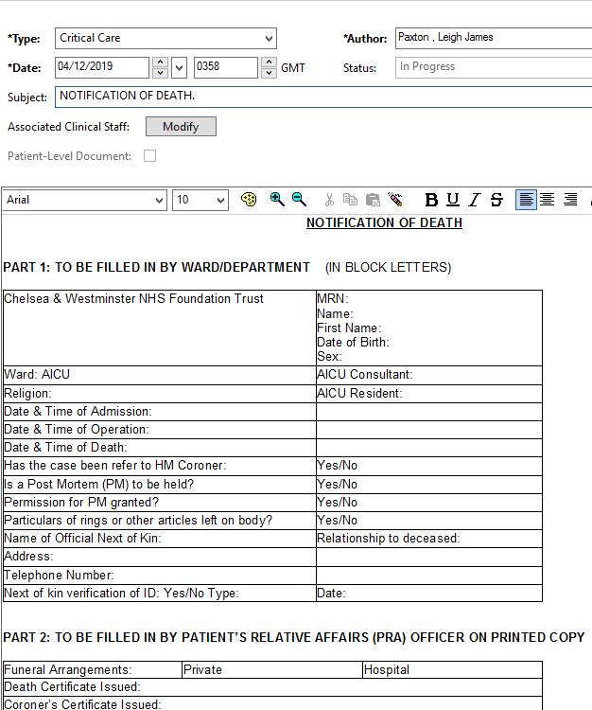

Slide 40
END OF LIFE INTER TEAM PROJECT
This is a group made up of various experienced nurses one member from each team. Each of us have a designated role.
We have a meeting every month to discuss progress on our projects.
We update the care plans.
We send bereavement cards 6 months after the patient’s death and again at a year milestone.
Currently we are trying to improve our compassionate care agreement care plan and trying to make it more user friendlier.
We are trying to make a folder with important information on different cultures, drugs that can be used and any other useful information in a user guide for everyone to learn.
Trying to identify a universal sign that can be used for pallative care patients so everybody’s aware of the situation.
This logo will also be presented on patient property bags so just as you took care of the patient you show respect for their belonging when handing them to their relatives. These could be precious momentos for the family

Slide 41
ANY QUESTIONS?

Slide 42
THANK YOU

